Slide 1

TRANSCEND - caCIS
Integration Architecture
August 2011

Slide 2
Contents
TRANSCEND to caCIS Semantic Adapter Interface
Mirth Connect Deployment Alternatives
OpenXDS Security
Data Element Mapping and Transformation
Appendix

Slide 3
1. TRANSCEND to Semantic Adapter Interface

Slide 4
TRANSCEND to Semantic Adapter Interface
Secure Web Service (SOAP) Interface - Service description document, WSDL and XSD for this interface shared with the TRANSCEND team
Same Web Service interface is used for the transfer of a clinical note to another site as well as transfer of clinical data to caCIS Clinical Data Warehouse
Tolven will invoke the Semantic Adapter web service and pass the following information as part of each request:
  Routing Instructions (only for Data Sharing Request)
    List of Recipients (Email addresses or ftp sites)
    List of corresponding Exchange document formats [HL7v2, CCD, RIM-ITS]
    Transfer mechanism [S-MIME/SMTP, SFTP, NAV/XDS, HTTPS*]
  Source Data Payload – TRIM – One of the four clinical notes or a consolidated TRIM containing all data for a patient (concatenation of 60+ TRIM files)
  Metadata - Study Identifier, Site Identifier, Subject Identifier, Initiating User Name
  *Note: The Solution Architecture is extensible such that caCIS integration platform can be later extended to invoke a HTTP-based REST or SOAP service at a remote site.

Slide 5
2. Mirth Connect Deployment Alternatives

Slide 6
MirthConnect Deployment - Background
Mirth Connect SSL plug-in currently does not support Secure Web Service interface
Starting from v2.2 (expected at the end of Oct.), the plug-in will support Secure Web Service interface
There are three options to address this in the context of caCIS deployment at TRANSCEND(UCSF):
  Implement SSL Tunneling using http server - Preferred option
  Implement SSL Tunneling using Mirth Appliance
  Continue development with current Mirth Connect version. Use Mirth Connect v2.2 for the actual deployment at TRANSCEND

Slide 7
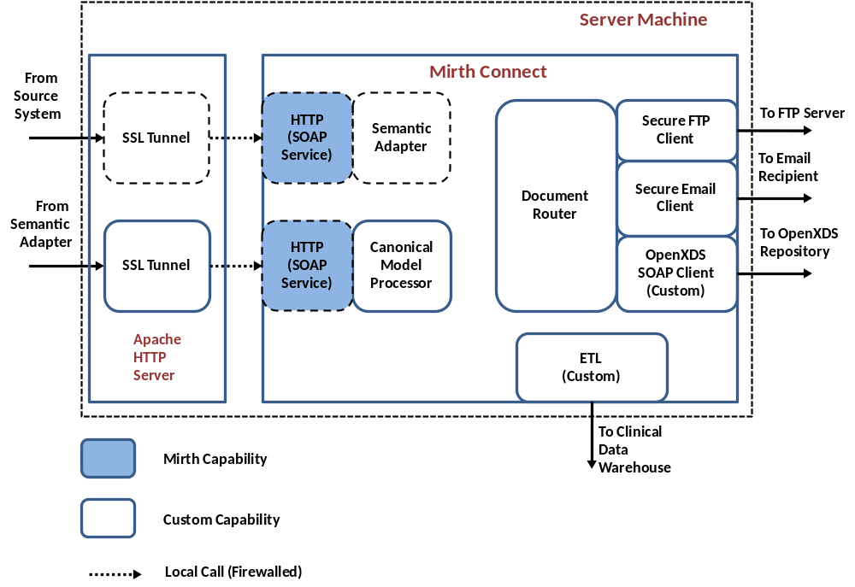
MirthConnect Deployment Alternatives – Option 1
  Implement SSL Tunneling using http server
  No additional development required
  Requires deployment and configuration of the HTTP server to create SSL tunnels
  This is the preferred option for the NCI Project team

Slide 8
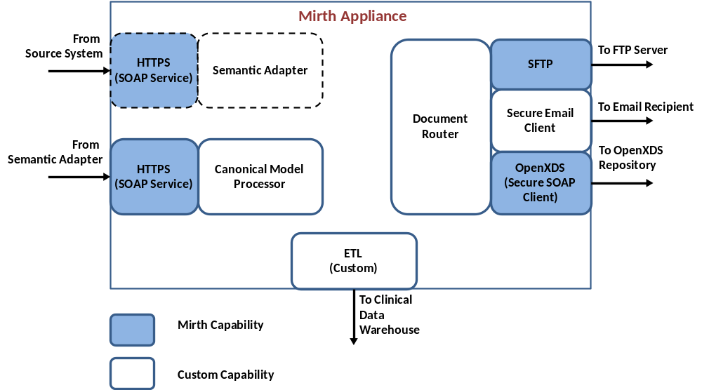
MirthConnect Deployment Alternatives – Option 2
  Implement SSL Tunneling using Mirth Appliance
  Requires purchase of Mirth Appliance ($2k to $40k)
  Requires installation (hardware) and configuration of Mirth Appliance

Slide 9
MirthConnect Deployment Alternatives – Option 3
  Continue development with the current Mirth Connect version (2.1); use Mirth Connect v2.2 for the actual deployment at TRANSCEND
  Allows the project team to continue development on the current path without interruption
  Adds significant testing effort and risk prior to deployment at TRANSCEND for the new version
  Adds risk that Mirth Connect will not release the new version on schedule, possibly delaying deployment at TRANSCEND

Slide 10
3. OpenXDS Security

Slide 11
caCIS Integration Platform
4. Retrieve
Document
(DocId)
3. Username /
Password
End User 1
Document Router
1. Publish
Document
OpenXDS
UPenn
System
(Recipient )
End User 2
UPenn
Cert.
End User N
6. Validate
Doc Id And Cert Ids.
Against Sec. Metadata
2. Store Doc Id
And Associated
Metadata
7. Retrieve Certificate’s
Study, Site and Patient Access
Study = “iSPY2”
Site = “UPenn”
Patient = “ABC123”
<ExchangeDoc>
<RIMITS>
</RIMITS>
</ExchangeDoc>
Exchange Metadata Master
Security Authorization Master
Doc Id
Study Id
Site Id
Patient Id
Cert Ids
Study | User ID
iSPY2 | UPenn
: | :
: | :
Site | User ID
UPenn | UPenn
: | :
: | :
Pt. | User ID
ABC123 | UPenn
: | :
: | :
Doc Id
Study Id
Site Id
Patient Id
Cert Ids
Doc Id
Study Id
Site Id
Patient Id
Cert Ids
5. Administrator manually provisions
Study, Site and Patient for the
Certificate id.
Optional Security Component
Security Provisioning
Document Router generates Exchange Document and Metadata and stores it within XDS
Store the Document Id and associated Certificate Ids as well as Study Id, Site Id and Patient Id as Security Metadata
End users log into the UPenn’s System with their local username and passwords and request the document
UPenn’s system connects to the OpenXDS Repository with its certificate and queries the document on user’s behalf passing the document id
This Certificate Id is granted access to appropriate study, site and patient in the security system by the administrator manually
OpenXDS Server validates if the Certificate Id is allowed access on the document
It then proceeds to perform secondary check to ensure that the user UPenn has access to the study, site and patient associated with the document by retrieving them from the Security Authorization Master

Slide 12
4. Data Element Mapping & Transformation

Slide 13
HL7v2 Transformation
  HL7v2 will be one of the supported document formats for document exchange
  The actual HL7v2 message format that is used for converting the source data to target document will be dependent on the requirements, constraints and capabilities of the target system e.g. EPIC in case of UPenn.
  However, to demonstrate the capability we will go ahead with implementing transformation for one of the clinical notes (Clinical Staging Note) to HL7v2 format
  We are looking to get any input related to the specific HL7v2 message format to use for Clinical Staging Note transformation by the end of August

Slide 14
Key Mapping and Transformation Assumptions
  The TRIM file containing all data for a patient for loading into CDW will be a concatenated file of all TRIMs for that patient, enclosed within some XML tag such as <trims>. There will be no TRIM blending performed.
  The approach will be to map all data elements from the input TRIMs for Clinical Notes to the Canonical (CDA) and then to target document formats.
  The approach will be to not drop any data elements from input TRIMs as long as they fit the target document format (e.g. no z-segments for HL7v2).

Slide 15
5. APPENDIX
caCIS Solution Architecture for Reference

Slide 16
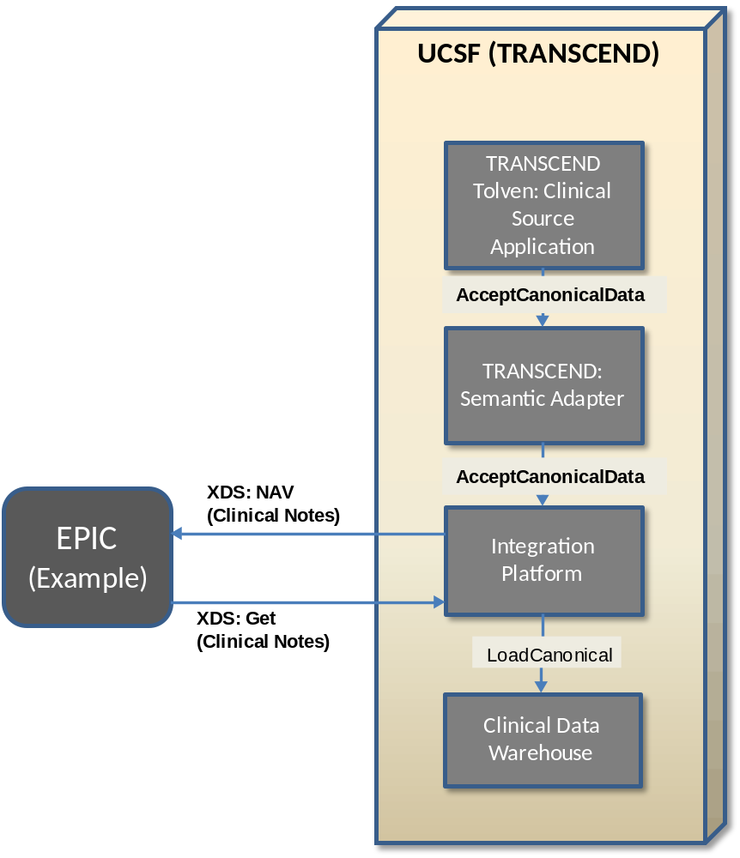
caCIS Architecture – TRANSCEND Deployment

Slide 17
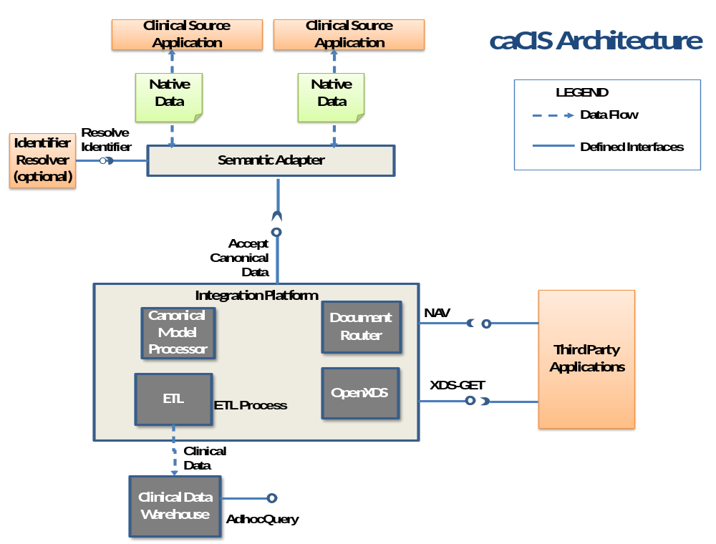

Slide 18
caCIS – Architectural Components - Definitions
No. | Term/Component | Definition
1. | Canonical format | Standards-based target data format that is used as a basis for creation of exchange instances and is also used to populate the Clinical Data Warehouse.
2. | Integration Platform (IP) | The overall caCIS infrastructure component that manages the verification of canonical information, generation and routing of exchange instances and management of transmission of data to the Clinical Data Warehouse. This is the component exposed to external systems involved in data exchange.
3. | Semantic Adapter (SA) | The component that transforms Internal Clinical Data into the Canonical format.
4. | OpenXDS | OpenXDS implements the Cross-Document Sharing (XDS) Registry and Repository. It is used for delivery of data to recipient systems.
5. | Document Router | The caCIS integration platform component responsible for managing the creation of exchange instances and delivering them to their intended recipients.
6. | Canonical Model Processor | The caCIS infrastructure component responsible for receiving information from various source systems (via their individual Semantic Adapter), validating the input data, transforming it into the warehouse persistence format and passing it to the clinical data warehouse.
7. | Clinical Data Warehouse | The repository where the Integration Platform persists clinical data for ad hoc querying.

Slide 19
caCIS – Architectural Components - Implementation Details
No. | Term/Component | Implementation Details
1. | Canonical format | Based on CCD and other broadly used CDA R2 templates
2. | Integration Platform (IP) | Mirth Connect (ESB)
3. | Semantic Adapter (SA) | Implementers can choose a platform that is acceptable to their enterprise. The caCIS integration platform is loosely coupled with the semantic adapter and this provides the flexibility to choose any implementation platform for SA.
4. | OpenXDS | OpenExchange provided by MOSS (Misys Open Source Solutions)
5. | Document Router | Deployed as component of the Integration Platform (on Mirth Connect)
6. | Canonical Model Processor | Deployed as a component of the Integration Platform (on Mirth Connect)
7. | Clinical Data Warehouse | Virtuoso - RDF/Triple store

Slide 20

caCIS – Architectural Components – Data Formats
Semantic Adapter
Integration Platform
Document Recipients
Data Warehouse
caCIS Request
caCIS Request
CDA/CCD
RDF Graph
Routing Instructions
(Optional)
Routing Instructions
(Optional)
OR
Meta Data
(Optional)
Meta Data
HL7v2 Document
:
:
:
OR
Source Data
(Any format)
Canonical Model Data and
Untransformed Source Data
RIM ITS

